Slide 1
MINI CAPSTONE PROJECT
LetsGetStarted
Industries
Network Infrastructure Design & Implementation
CSCI 1772 – NETWORKING I | COLUMBUS STATE COMMUNITY COLLEGE | MAY 5, 2026

Slide 2
WHO WE ARE
Company Overview
Startup company generating $200 million in gross annual revenues
Builds and sells computer systems, chips, parts, and peripherals
Partners with major Fortune 50 and Fortune 100 companies to purchase parts
Corporate headquarters in Dallas, Texas with 6 satellite offices across the United States
~120 employees across all 7 locations — each user is unique to their office with no duplication

Slide 3
Office Locations & Departments
Dallas, TX — Corporate Headquarters
Chicago, IL & Milwaukee, WI — Shipping & Receiving
30 Users — Executive Office
10 Users Each — 20 Total
Executive Leadership
Finance
HR
IT Administration
Warehouse Ops
Shipping
Receiving
Inventory Mgmt
Supply Chain
Full access to ALL resources across the entire organization
Access to all network resources — inventory tracking & supply chain
Atlanta, GA & San Francisco, CA — Sales & Service
Austin, TX & Seattle, WA — Distribution & DC
10 Remote Users Each — 20 Total
— 10 users, all network resources
Sales
Customer Service
Account Mgmt
— 20 users, DC-scoped resources
Atlanta also serves as a (+20 DC users)
Distribution Ops
Data Center Ops
Network Engineering
Remote workforce supporting customer-facing operations
Austin: all network resources · Seattle: DC-scoped access

Slide 4
Organization Chart
CORPORATE LEADERSHIP HIERARCHY
LEVEL 1 — EXECUTIVE
CEO
Dallas, TX
Oversees all company operations
from corporate headquarters
LEVEL 2
LEVEL 2
LEVEL 2
LEVEL 2
VP Sales
Atlanta & San Francisco
Manages sales teams across
two regional offices
VP Operations
Chicago, Milwaukee & Austin
Oversees shipping centers
and distribution operations
VP IT / CTO
Seattle & Atlanta
Manages data centers and
all IT infrastructure
CFO
Dallas, TX (HQ)
Oversees Finance and
HR departments
LEVEL 3
Sales Manager
Atlanta
Sales Manager
San Francisco
Shipping Manager
Chicago
Shipping Manager
Milwaukee
Distribution Mgr
Austin
Data Center Mgr
Seattle
Dept. Managers
Data Center Mgr
Atlanta
Finance Manager
Dallas
HR Manager
Dallas
LEVEL 4 — STAFF & SPECIALISTS
Sales Representatives
Customer Service Agents
Warehouse Staff
Network Engineers
Systems Administrators
Help Desk Technicians
Accounting Staff

Slide 5
User Breakdown by Location
120
Total Users
Unique users across 7 locations — no duplication
30
Executive Users (Dallas)
Full access to all resources organization-wide
40
Shipping, Receiving & Distribution
Chicago 10 + Milwaukee 10 + Austin 10 — full network access
50
Sales/CS & Data Center Users
Atlanta 30 (10 Sales + 20 DC) | SF 10 (Sales) | Seattle 20 (DC)
DETAILED LOCATION BREAKDOWN
LOCATION
FUNCTION
NOTES
USERS
Executive
All-access, organization-wide privileges
30
Shipping / Receiving
Warehouse operations
10
Shipping / Receiving
Warehouse operations
10
Sales/CS + Data Center
10 Sales/CS remote + 20 Data Center
30
Sales / CS Remote
Remote customer-facing team
10
Distribution Center
Regional distribution hub
10
Data Center
Infrastructure & operations
20

Slide 6
Network Segmentation Strategy
VLAN architecture, VPN connectivity, QoS enforcement & monitoring across all sites
VLAN-Based Segmentation
Inter-VLAN Routing with ACLs
6 VLANs per site isolate traffic by function: Management, Servers, Staff, Guest, VoIP, and DMZ
Layer 3 switches handle routing between VLANs with access control lists restricting cross-VLAN traffic
VPN Connectivity
Remote User Access
Encrypted IPSec site-to-site VPN tunnels connecting all 7 locations to Dallas HQ
SSL VPN for 20 remote sales/CS users in Atlanta and San Francisco
QoS & Traffic Prioritization
Network Monitoring
VoIP VLAN traffic prioritized; guest VLAN bandwidth-limited and isolated from production
SNMP and syslog monitoring on all managed switches and routers for real-time visibility
VLAN 10 · MGMT
VLAN 20 · SERVERS
VLAN 30 · STAFF
VLAN 40 · GUEST
VLAN 50 · VOIP
VLAN 60 · DMZ

Slide 7
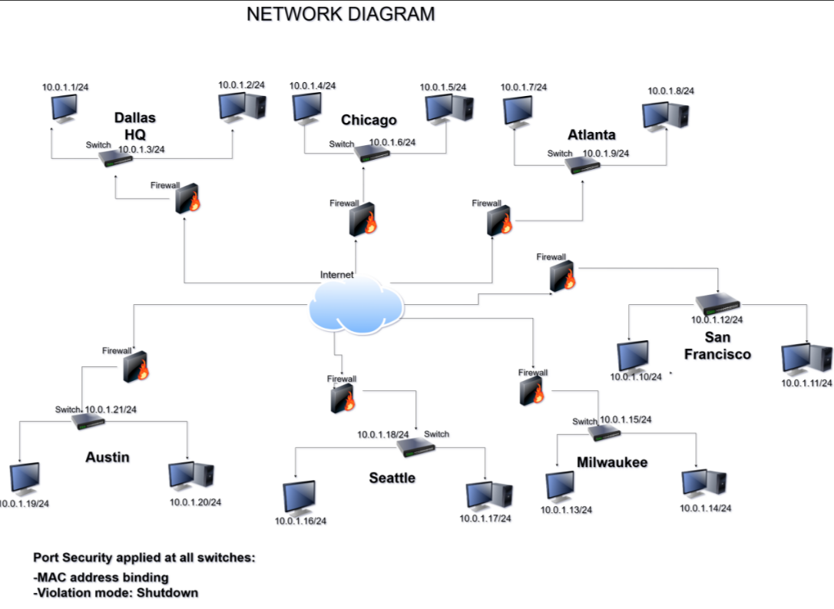
Network Diagram

Slide 8
IP Addressing Scheme — Part 1
Dallas HQ
10.10.0.0 /16
Chicago & Milwaukee
Shipping / Receiving Sites
VLAN 10 Mgmt
10.0.1.1/24
Chicago
10.0.1.4/24
VLAN 20 Servers
10.0.1.4/24
VLAN 10
10.20.10.0/24
VLAN 20
10.20.20.0/24
VLAN 30 Staff
10.0.1.7/24
VLAN 30
10.20.30.0/24
VLAN 40
10.20.40.0/24
VLAN 50
10.20.50.0/24
VLAN 60
10.20.60.0/24
VLAN 40 Guest
10.0.1.10/24
VLAN 50 VoIP
10.0.1.13/24
Milwaukee 10.0.1.13/24
VLAN 10
10.30.10.0/24
VLAN 20
10.30.20.0/24
VLAN 60 DMZ
10.0.1.16/24
VLAN 30
10.30.30.0/24
VLAN 40
10.30.40.0/24
Default Gateway
.1 on each subnet
VLAN 50
10.30.50.0/24
VLAN 60
10.30.60.0/24
Primary DNS
10.10.20.10
Secondary DNS
10.10.20.11

Slide 9
IP Addressing Scheme — Part 2
Sites 4–7 · Continued VLAN Allocation across Regional Offices
Atlanta & San Francisco — Sales/CS + Data Center
Austin & Seattle — Distribution + Data Center
10.40.0.0 /16
10.60.0.0 /16
V10
10.40.10.0/24
Mgmt
V20
10.40.20.0/24
Servers/DC
V10
10.60.10.0/24
Mgmt
V20
10.60.20.0/24
Servers/DC
V30
10.40.30.0/24
Staff
V40
10.40.40.0/24
Guest
V30
10.60.30.0/24
Staff
V40
10.60.40.0/24
Guest
V50
10.40.50.0/24
VoIP
V60
10.40.60.0/24
DMZ
V50
10.60.50.0/24
VoIP
V60
10.60.60.0/24
DMZ
10.50.0.0 /16
10.70.0.0 /16
V10
10.50.10.0/24
Mgmt
V20
10.50.20.0/24
Servers/DC
V10
10.70.10.0/24
Mgmt
V20
10.70.20.0/24
Servers/DC
V30
10.50.30.0/24
Staff
V40
10.50.40.0/24
Guest
V30
10.70.30.0/24
Staff
V40
10.70.40.0/24
Guest
V50
10.50.50.0/24
VoIP
V60
10.50.60.0/24
DMZ
V50
10.70.50.0/24
VoIP
V60
10.70.60.0/24
DMZ
Consistent 6-VLAN model across all sites · /24 subnets = 254 usable hosts per VLAN

Slide 10
ARCHITECTURE OVERVIEW
Network Diagram Summary
WAN Connectivity
Core Infrastructure
All 7 sites connected to Dallas HQ via encrypted IPSec site-to-site VPN tunnels over dedicated WAN links
Each site has a Domain Controller, DHCP server, Layer 3 switch for inter-VLAN routing, and next-gen firewall
42 Total Subnets
Perimeter Security
6 VLANs × 7 sites, each with /24 addressing providing 254 usable hosts per segment
Firewall with IDS/IPS at every location, DMZ VLAN isolating public-facing services
Data Center Redundancy
Technical Documentation
Dual data centers (Seattle & Atlanta) for geographic redundancy and disaster recovery
Full Visio/draw.io network diagrams showing topology, IP scheme, VPN tunnels, and security zones per site
7 SITES · 42 SUBNETS · FULL REDUNDANCY

Slide 11
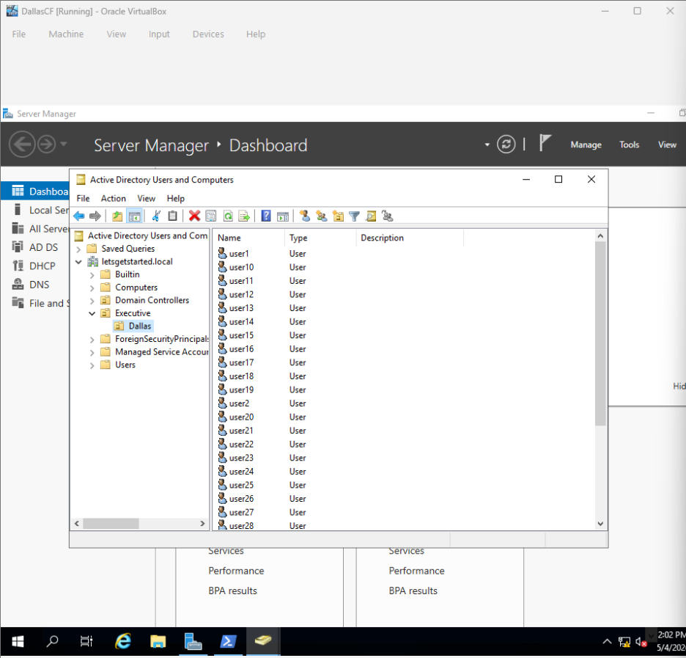
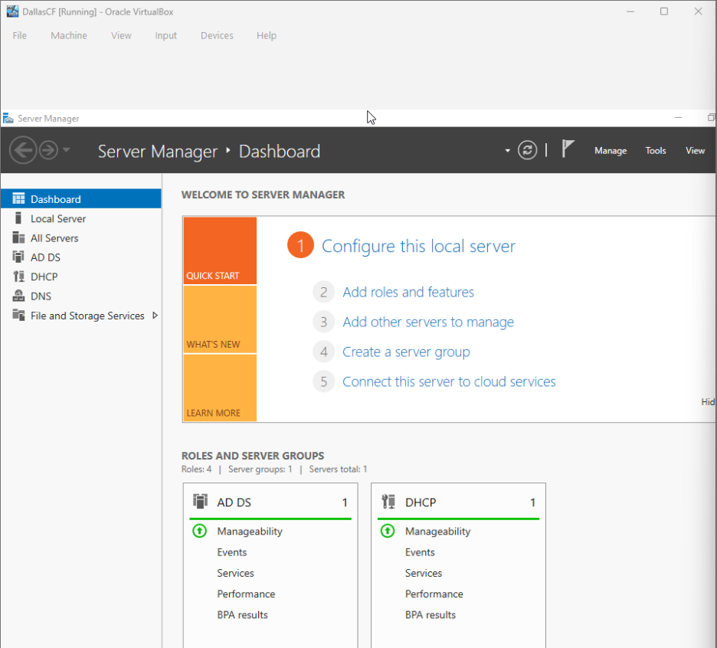
Network Infrastructure - DALLAS

Slide 12
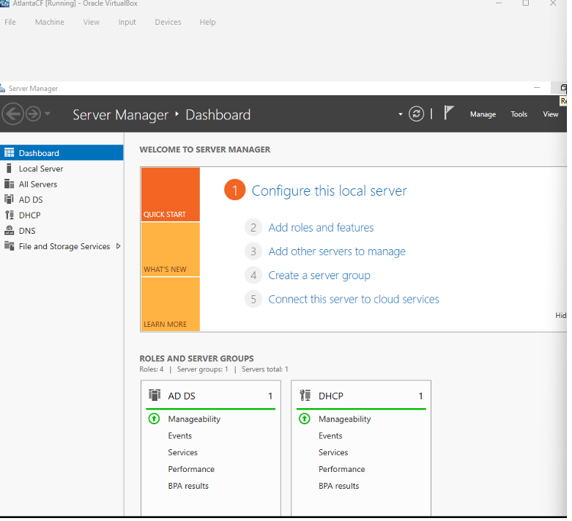
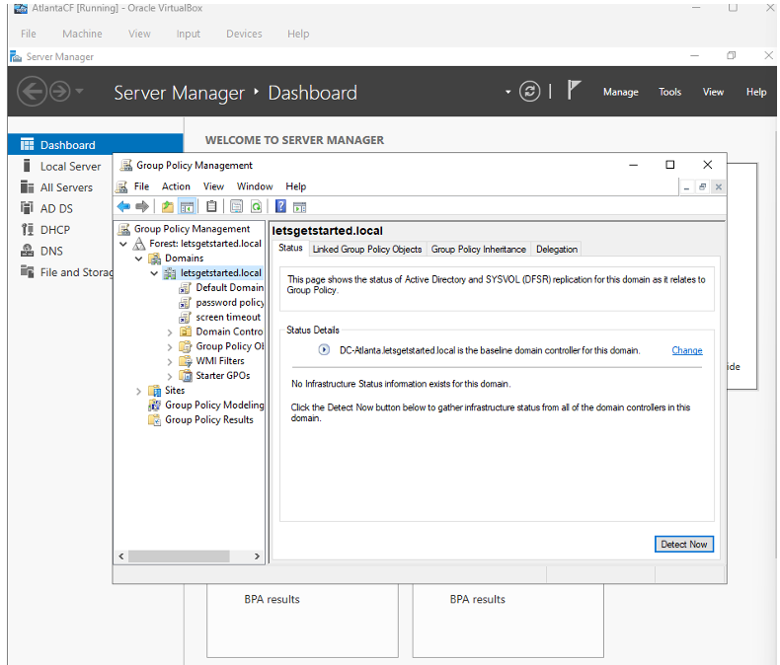
Network Infrastructure - ATLANTA

Slide 13
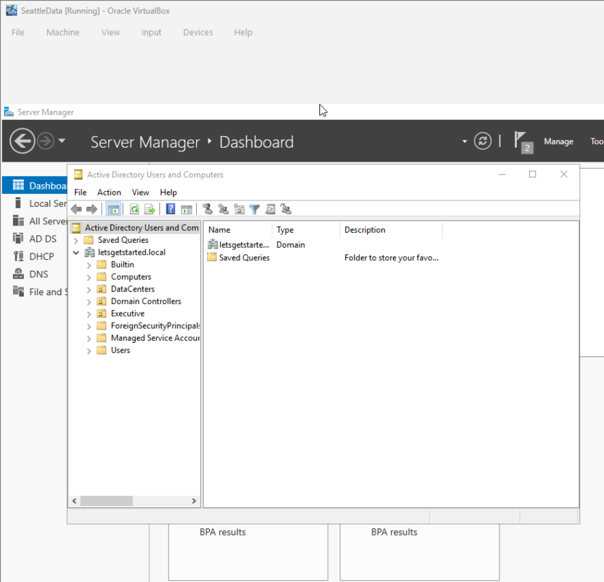
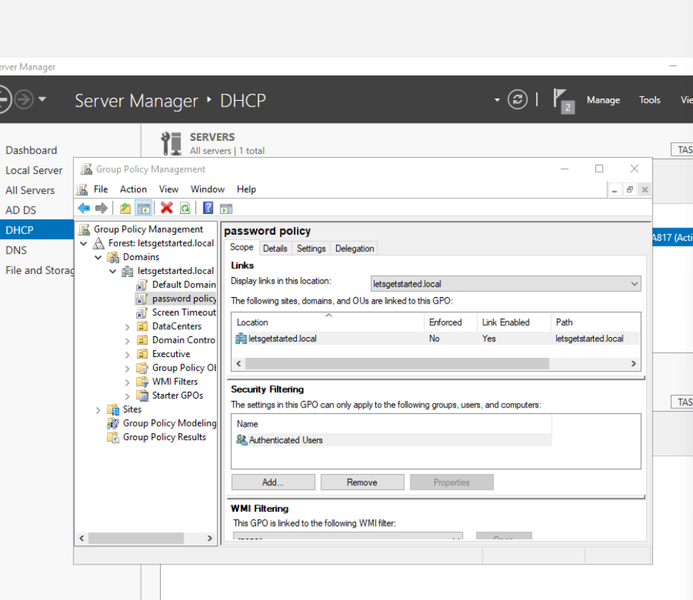
Network Infrastructure - SEATTLE

Slide 14
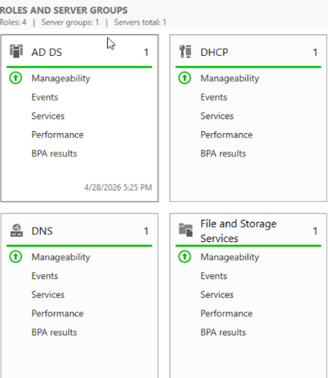
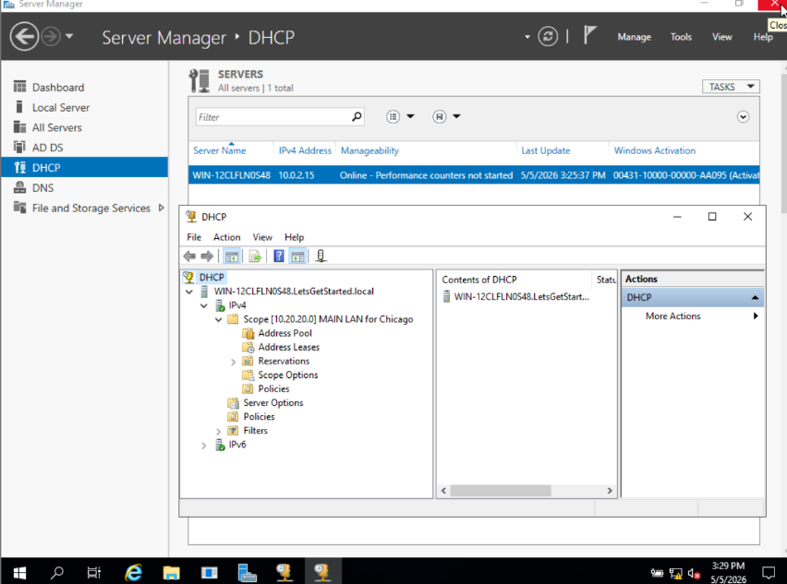
Network Infrastructure - CHICAGO

Slide 15
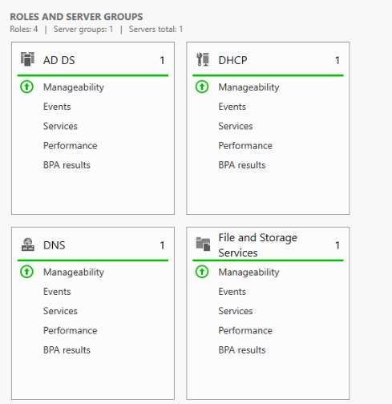
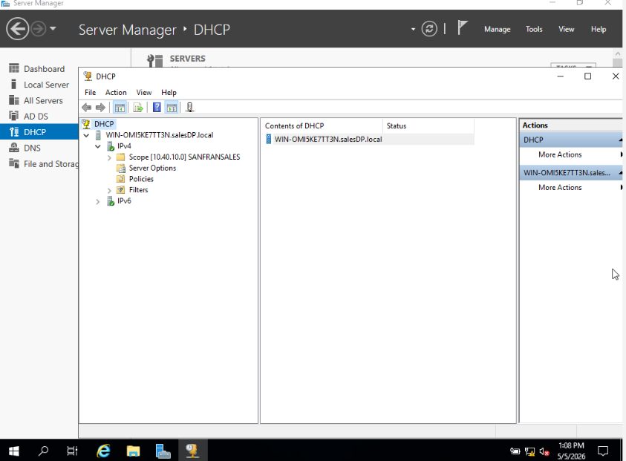
Network Infrastructure – SAN FRANCISCO LSALES

Slide 16
Network Infrastructure – MILWAUKEE-SHI-REC

Slide 17
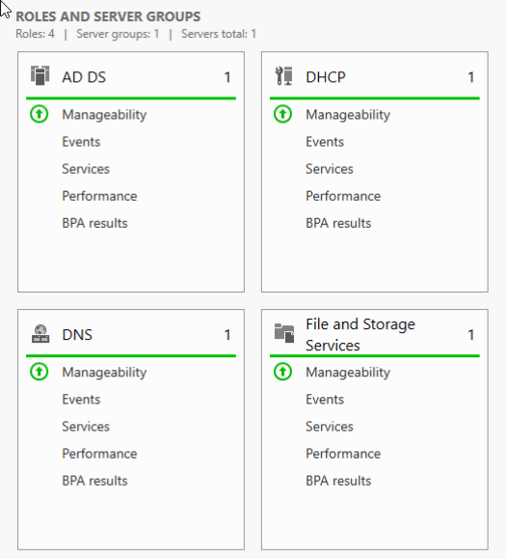
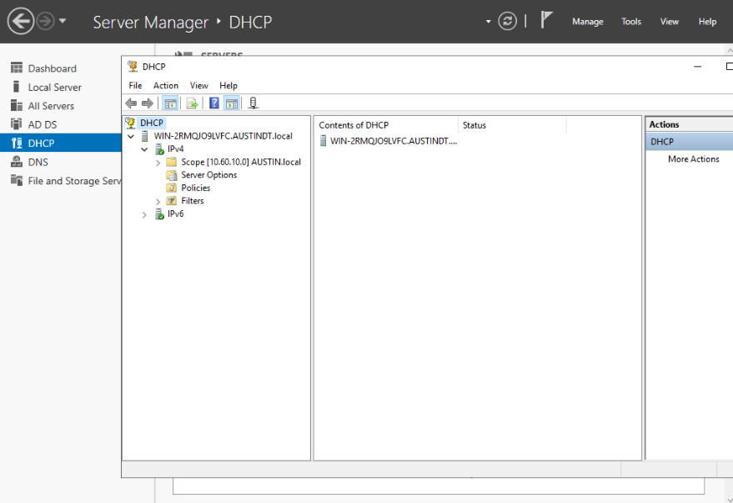
Network Infrastructure – AUSTIN DIS-DETACT

Slide 18
ACTIVE DIRECTORY ARCHITECTURE
Forest, Domain & Domain Controllers
Forest & Domain Design
Domain Controllers
Site Topology
Single forest, single domain: letsgetstarted.local
1 DC deployed at each of the 7 locations (7 DCs total)
AD Sites: Dallas, Chicago, Milwaukee, Atlanta, San Francisco, Austin, Seattle
Windows Server 2019 functional level
Centralized management from Dallas HQ
Dallas DC01 holds all 5 FSMO roles
Subnet-to-site mappings ensure clients authenticate to local DC
Consistent naming convention across all sites
AD Sites & Services configured for inter-site replication
Site links configured with cost values to optimize replication traffic
Replication: 15 min within sites, 60 min between sites
Each DC runs DNS Server role for local name resolution
DOMAIN:
LETSGETSTARTED.LOCAL
DCS:
7
SITES:
7
FUNCTIONAL LEVEL:
2019

Slide 19
ACTIVE DIRECTORY
Organizational Units, Users & Groups
OU Structure by Location
Top-level OUs: OU=Dallas, OU=Chicago, OU=Milwaukee, OU=Atlanta, OU=SanFrancisco, OU=Austin, OU=Seattle
Sub-OUs by Department
The hierarchical OU structure mirror's physical locations, with department-based sub-OUs, dedicated computer containers, and security groups for granular access control.
Executive, Sales, CustomerService, Shipping, Receiving, Distribution, DataCenter, IT, Finance, HR (varies by site function)
Computer & Server OUs
Separate OUs for Workstations, Servers, and Printers under each location OU for targeted GPO application
User Accounts
120 unique user accounts created across all locations, placed in appropriate location and department OUs
Security Groups
Department-based security groups (e.g., GRP_Dallas_Executive, GRP_Chicago_Shipping) for resource access and NTFS permissions

Slide 20
DHCP, DNS & Network Services
DHCP Configuration
DNS Configuration
1
DHCP Server on Every Server
1
AD-Integrated DNS
Each of the 7 locations has DHCP running on its local Domain Controller
DNS zones stored in Active Directory for secure, replicated name resolution
2
Scopes per VLAN
2
Forward Lookup Zone
6 DHCP scopes per site (one per VLAN) with appropriate address ranges within the /24 subnets
letsgetstarted.local zone replicated to all DCs across all 7 sites
3
Reverse Lookup Zones
3
Reservations
PTR records configured for each subnet (10.10.x, 10.20.x through 10.70.x)
Static DHCP reservations for servers, printers, network devices, and management interfaces
4
DNS Forwarders
External DNS forwarders configured for internet name resolution (e.g., 8.8.8.8, 1.1.1.1)
4
Lease Duration
Scavenging
8-hour lease for Staff/Guest VLANs, 24-hour lease for Servers/Management VLANs
5
DNS aging and scavenging enabled to remove stale records automatically
5
Failover
DHCP failover configured between local DC and Dallas HQ for redundancy

Slide 21
PowerShell Automation Scripts
14+ SCRIPTS ACROSS 7 SERVERS
SCRIPT 1
SCRIPT 2
Bulk User Provisioning
Automated Group Membership
Import-CSV reads employee data and creates AD accounts with correct OU placement, department, title, and group membership per location.
Assigns users to appropriate security groups based on department and location for NTFS and resource access.
SCRIPT 3
SCRIPT 4
System Health Check
Password Expiry Notification
Validates DC replication status, DHCP scope utilization, disk space, and critical service health across all servers.
Sends automated email alerts to users 14, 7, and 3 days before password expiration.
SCRIPT 5
SCRIPT 6
Backup Verification
Inventory Audit Report
Nightly script validates Windows Server Backup completion and logs results for review.
Queries AD for all computer objects, last logon dates, and OS versions; exports to CSV for asset tracking.
All scripts tested end-to-end across all 7 servers before instructor sign-off | Execution logs saved centrally

Slide 22
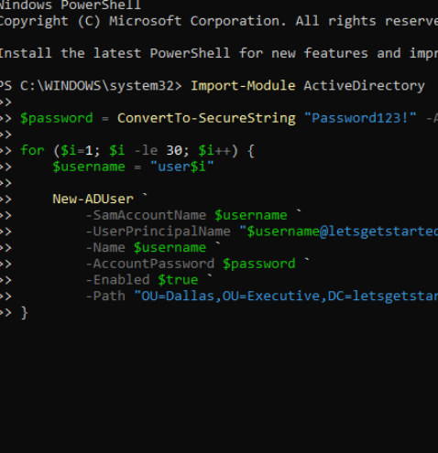
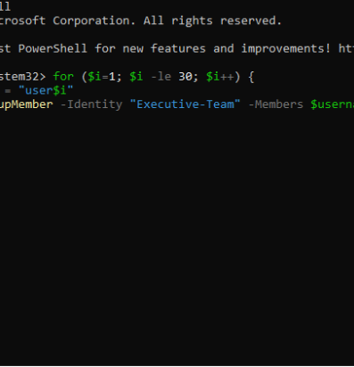

Slide 23
Group Policy Objects (GPOs)
7+
GPOS
One GPO per server minimum — centralized policy enforcement across all 7 servers
GPO 1: Password & Account Lockout Policy
01
Minimum 12 characters, complexity enabled, 90-day maximum age, 5 invalid attempts triggers 30-minute lockout
GPO 2: Drive Mappings & Folder Redirection
02
Department-specific network drive mappings via Group Policy Preferences with Item-Level Targeting by security group
GPO 3: Software Restriction / AppLocker
03
Whitelist-based application control blocking unauthorized executables, scripts, and installers
GPO 4: Security Baselines
04
Windows Firewall rules enabled, advanced audit logging, USB storage device restrictions, screen lock after 10 minutes
GPO 5: Desktop Standards
05
Corporate wallpaper, Start menu layout, default browser and homepage settings, Control Panel restrictions for standard users
GPO 6: Windows Update / WSUS Policy
06
Automatic updates from internal WSUS server, scheduled installation during maintenance windows
GPO 7: Printer Deployment
07
Location-based printer deployment using Item-Level Targeting to auto-map department printers
7+ GPOs linked to appropriate OUs
|
Tested and verified at all locations

Slide 24
Operations Database — Overview & Tables
Core schema structure powering warehouse logistics, procurement, and financial tracking
Database Platform
Suppliers & Products
Database Name: Operations
Suppliers — 20 records
Engine: MS SQL Server or MS Access
PK SupplierID
CompanyName
ContactName
Phone
Email
Address
City
State
Purpose: Tracks and captures warehouse information across all operational workflows
Products — 50 records
Shipping
Receiving
Inventory
Invoicing
PK ProductID
ProductName
Category
UnitPrice
FK SupplierID
Description
Status
Inventory
Shipping/Receiving & Invoices
Inventory — 50 records
Shipping/Receiving — 30 records
PK InventoryID
FK ProductID
QuantityOnHand
WarehouseLocation
PK ShipRecvID
OrderType
FK ProductID
Quantity
Carrier
TrackingNo
ReorderLevel
ReorderQuantity
LastUpdated
ShipDate
RecvDate
Status
Tracks across the Austin distribution center
Invoices — 30 records
PK InvoiceID
FK SupplierID
InvoiceDate
DueDate
TotalAmount
PaymentStatus

Slide 25
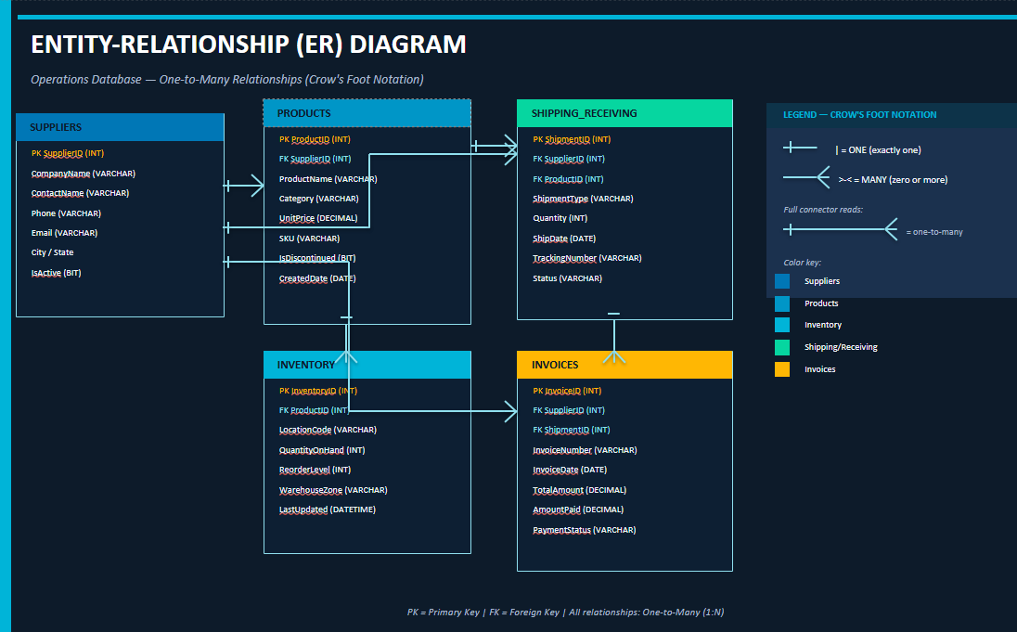
Database Schema & Relationships
Entity relationships enforced through foreign key constraints
Schema designed in Third Normal Form (3NF)
ERD submitted for instructor review & sign-off
PKs, FKs, and constraints documented

Slide 26
Database Schema & Relationships
Entity relationships enforced through foreign key constraints
1
2
3
4
SUPPLIERS → PRODUCTS
PRODUCTS → INVENTORY
PRODUCTS → SHIPPING
SUPPLIERS → INVOICES
One-to-Many
One-to-One / One-to-Many
One-to-Many
One-to-Many
Linked via SupplierID foreign key
Linked via ProductID foreign key
Linked via ProductID foreign key
Linked via SupplierID foreign key
Each supplier can provide multiple products
Tracks quantity, location, and reorder levels
Tracks inbound & outbound shipments
Multiple invoices per supplier for parts purchased
Referential integrity enforced with CASCADE on update
Each product tracked in inventory records
Covers Chicago and Milwaukee locations
Tracks payment status and due dates
Schema designed in Third Normal Form (3NF)
ERD submitted for instructor review & sign-off
PKs, FKs, and constraints documented

Slide 27
Database Security & Permissions Matrix
Comprehensive access controls aligned with organizational roles and compliance requirements
Database Security Plan
Permissions Matrix by Role
1
Windows Authentication
FULL CONTROL Executive / IT Admin
SELECT, INSERT, UPDATE, DELETE on all 5 tables · Can manage schema & database settings
Integrated with Active Directory; users authenticate with their domain credentials
2
Role-Based Access Control
MODIFY Shipping/Receiving Staff — Chicago, Milwaukee
SELECT, INSERT, UPDATE on Shipping/Receiving, Inventory, Products · READ-ONLY Suppliers, Invoices
Database roles aligned with AD security groups per department
3
Encryption
TLS 1.2 for data in transit; Transparent Data Encryption (TDE) for data at rest
MODIFY Distribution Staff — Austin
SELECT, INSERT, UPDATE on Inventory, Shipping/Receiving · READ-ONLY Products, Suppliers, Invoices
4
Auditing
SQL Server audit logging tracks all data modifications, login attempts, and permission changes
READ-ONLY Sales / CS — Atlanta, San Francisco
SELECT on Products & Inventory only · NO ACCESS Suppliers, Shipping/Receiving, Invoices
5
Backups
Automated nightly backups with 30-day retention; weekly full + daily differential
DBA Data Center Staff — Seattle, Atlanta DC
DBA-level access for database maintenance and backup operations
PRINCIPLE OF LEAST PRIVILEGE · DEFENSE IN DEPTH · ZERO TRUST

Slide 28
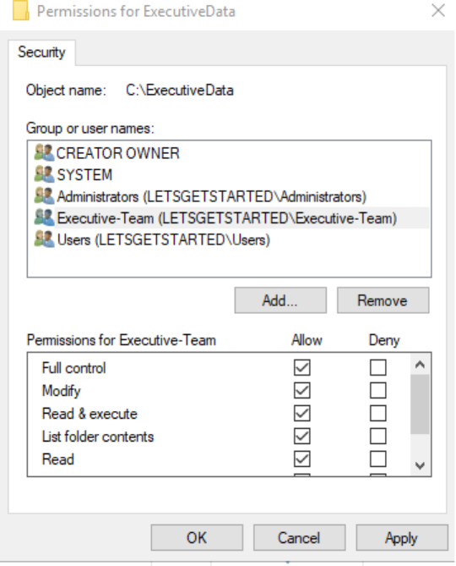
Permissions

Slide 29
Comprehensive Network Security Strategy
Firewalls
Port Security
Next-generation firewalls at each site perimeter with stateful packet inspection, IDS/IPS, and DMZ for public-facing services
802.1X port-based network access control, MAC address filtering, unused switchport shutdown, VLAN assignment enforcement
Network Monitoring & Event Logs
File/Folder NTFS Permissions
Centralized SIEM for log aggregation from all 7 sites, real-time alerting, Windows Event Log auditing on every server
Least privilege model with department-based security groups: Full Control (Admin), Modify (IT), Read/Write (Staff), Read-Only (Guest)
Network & Data Security
Technical Documentation
Encrypted site-to-site VPN, SSL VPN for remote users, BitLocker drive encryption on all workstations, MFA for remote access
Complete security policy manual, network diagrams, incident response procedures, and compliance documentation

Slide 30
DATA PROTECTION
Backup, Disaster Recovery & Business Continuity
Layered resilience ensuring data integrity, rapid recovery, and uninterrupted operations
Backup Strategy
(3-2-1 Rule)
Disaster Recovery Plan
Business Continuity Plan (BCP)
Testing & Validation
Dual data centers: Seattle & Atlanta for geographic redundancy
Monthly backup restoration tests to verify data integrity
3 copies of all data
Remote VPN access enables staff to work from any location
2 different storage media (local disk + offsite)
RPO: 1 hour (max data loss)
Quarterly DR failover drills between Seattle & Atlanta
RTO: 4 hours (max downtime)
Critical services hosted across both data centers
1 offsite copy replicated to alternate data center
AD replication ensures domain services restored quickly
Documented test results and remediation actions
Communication plan for staff notification during outages
Windows Server Backup + SQL Server backup agents
Documented failover procedures for each critical system
PowerShell backup verification script runs nightly & logs results
Annual BCP testing and tabletop exercises
Nightly incremental, weekly full backups
Documented roles & responsibilities during incidents
RPO
1 Hour
RTO
4 Hours
Data Centers
Seattle & Atlanta
Backup Cadence
Nightly + Weekly

Slide 31
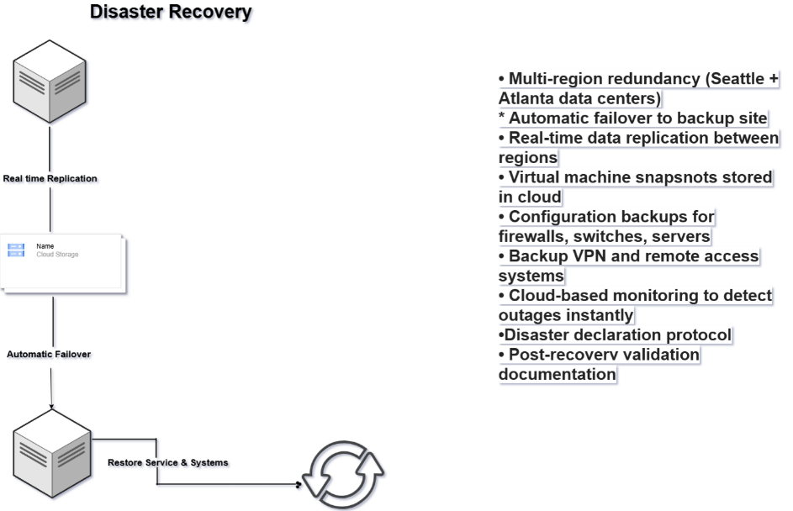
Disaster Recovery

Slide 32
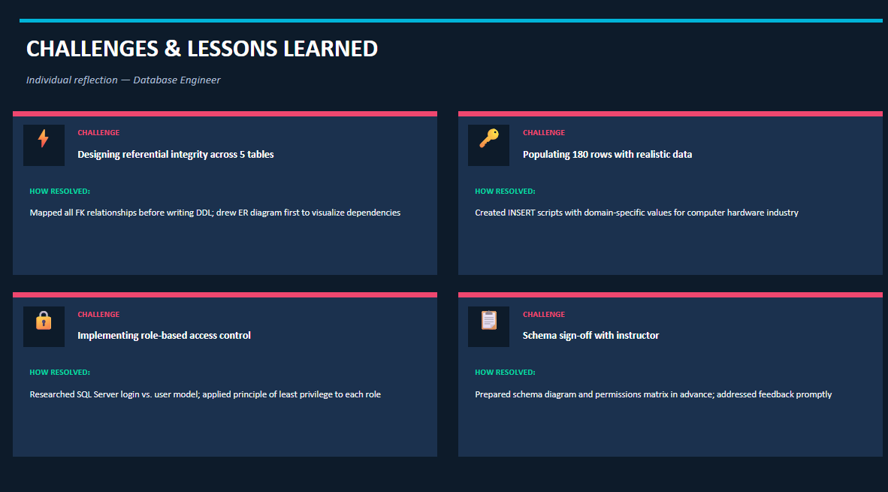

Slide 33
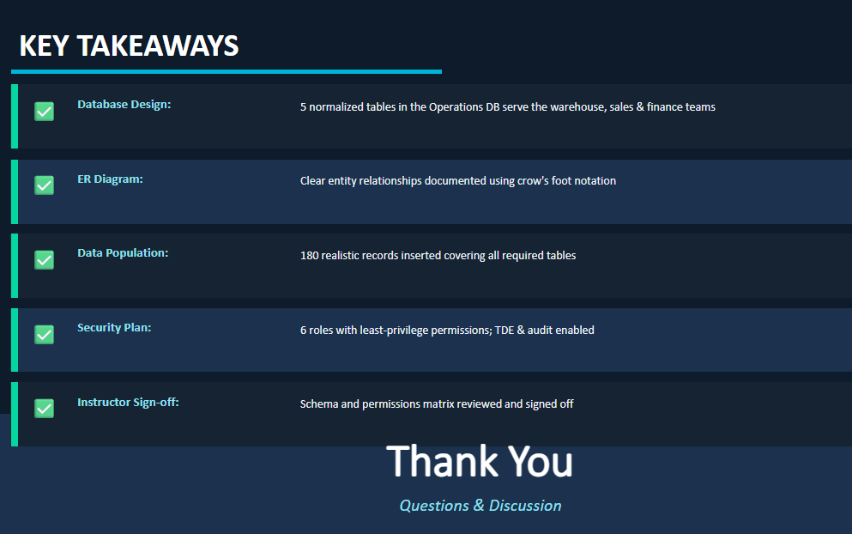

Slide 34
Project Workplan — Tasks 1–5
PHASE 1
Team Size: 6 Members · All Statuses: Not Started
Task 1: Create Organization Chart
NOT STARTED
Achraf
Apr 15 – Apr 17, 2026
Dependencies: None
Build high-level org chart in PowerPoint
Task 2: Identify Departments per Location
NOT STARTED
Achraf
Apr 15 – Apr 18, 2026
Dependencies: None
Determine departments for Dallas, Chicago, Milwaukee, Atlanta, SF, Seattle, Austin
Task 3: Create Project Timeline / Workplan
NOT STARTED
Sarah
Apr 15 – Apr 19, 2026
Dependencies: None
Build full project timeline and workplan document
Task 4: Design Network Diagram
NOT STARTED
Sarah
Apr 18 – Apr 24, 2026
Dependencies: Task 2
Create network segmentation, IP scheme, firewalls, security, monitoring, DR/BCP
Task 5: Build Network Infrastructure
NOT STARTED
Jeff & Calib
Apr 20 – Apr 28, 2026
Dependencies: Task 4
Calib: Dallas, Seattle, Atlanta | Jeff: Austin, Chicago, Milwaukee, San Francisco · AD, DHCP, GPOs, PowerShell scripts, users/groups, NTFS permissions, security

Slide 35
Project Workplan — Tasks 6–9 & Timeline Summary
Remaining Tasks
Timeline Summary (Apr 15 – May 5)
Task 6: Build Operations Database
TASK
ASSIGNED TO
START
END
Assigned To: Samiratou Boro · Apr 18 – Apr 26, 2026
Org Chart
Achraf
Apr 15
Apr 17
Create database, tables, relationships, security, populate records
Departments
Achraf
Apr 15
Apr 18
Dependencies: Task 2
Project Timeline
Sarah
Apr 15
Apr 19
Task 7: Testing & Instructor Sign-off
Network Diagram
Sarah
Apr 18
Apr 24
Assigned To: Charles · Apr 29 – May 2, 2026
Network Infra
Jeff & Calib
Apr 20
Apr 28
Test AD, scripts, GPOs, database, network diagram; obtain instructor approval
Database Build
Samiratou
Apr 18
Apr 26
Dependencies: Tasks 5 & 6
Testing & Sign-off
Charles
Apr 29
May 2
Task 8: Prepare Presentation
Presentation Prep
Charles
Apr 29
May 4
Assigned To: Charles · Apr 29 – May 4, 2026
Final Presentation
All Members
May 5
May 5
Build slides, rehearse, finalize content
Dependencies: Tasks 1–6
SPRINT DURATION
Task 9: Final Presentation
Apr 15
May 5
Assigned To: All Team Members · May 5, 2026
▲ Today (Apr 28)
21 days total · 7 remaining
Deliver 15-minute presentation in class
Dependencies: Task 8

